Slide 1
Stacks
Objectives
Upon completion you will be able to
Explain the design, use, and operation of a stack
Implement a stack using a linked list structure
Understand the operation of the stack ADT

Slide 2
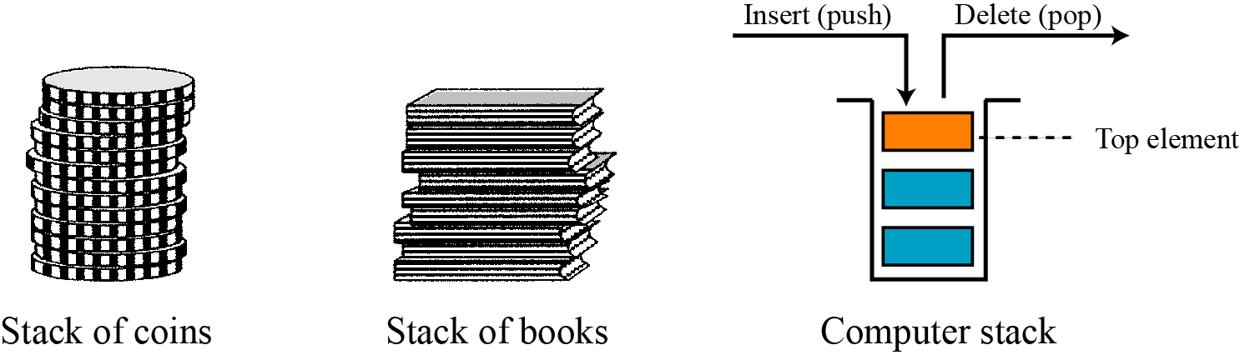
STACKS
A stack is a restricted linear list in which all additions and deletions are made at one end, the top. If we insert a series of data items into a stack and then remove them, the order of the data is reversed. This reversing attribute is why stacks are known as last in, first out (LIFO) data structures.
Three representations of stacks

Slide 3
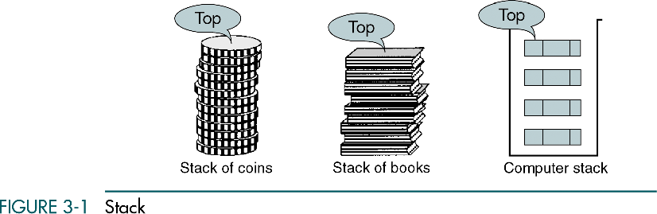

Slide 4
Basic Stack Operations
The stack concept is introduced and three basic stack operations are discussed.
Push
Pop
Stack Top

Slide 5
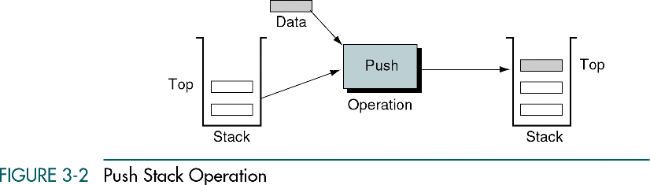

Slide 6
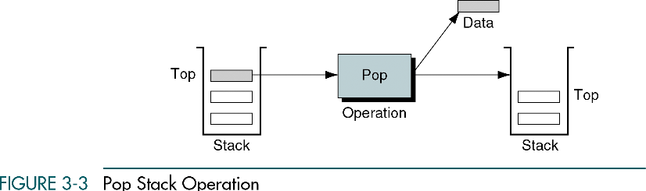

Slide 7
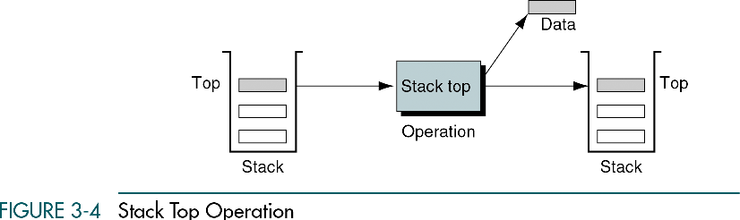

Slide 8
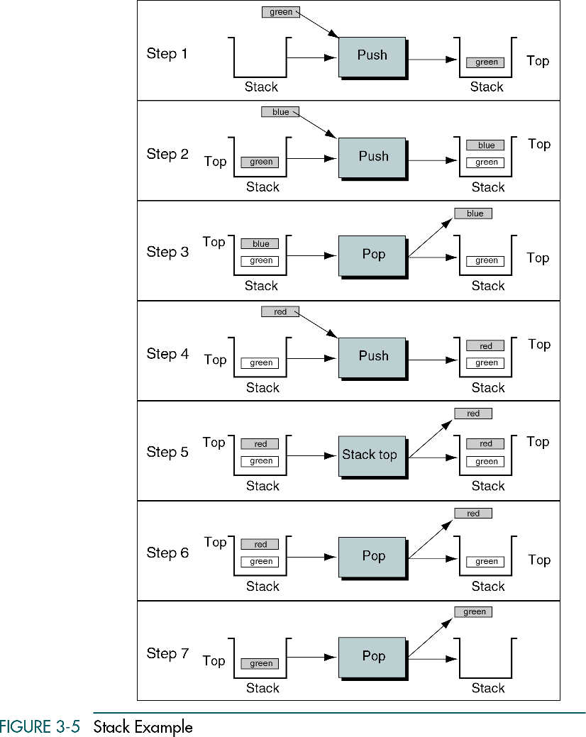

Slide 9
3-2 Stack Implementation
Stack can be implemented using any one of the following approach:
Array Implementation
Linked list representation

Slide 10
Array Implementation of stack
/* stack structure*/
struct stack {
int s[size];
int top;
}st;
void push(int item)
{
if(st.top>=size-1)
{
printf("\n stack is full!\t Overflow....");
}
st.top++;
st.s[st.top] =item;
}
int pop()
{
int item;
item=st.s[st.top];
st.top--;
return(item);
}

Slide 11
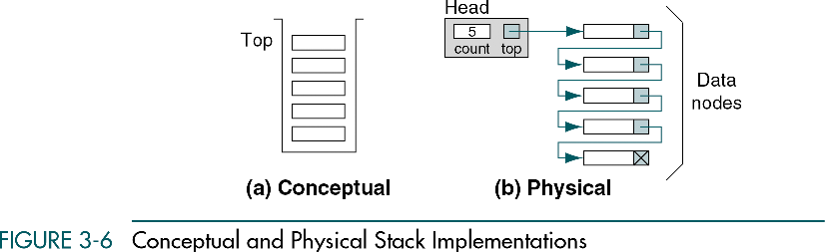
Linked list Implementation of stack

Slide 12
Linked list Implementation of stack
struct Node
{
int Data;
struct Node *next;
}*top=NULL;
void push(int value)
{
struct Node *temp;
temp=(struct Node *)malloc(sizeof(struct Node));
temp->Data=value;
if (top == NULL)
{
top=temp;
top->next=NULL;
}
else
{
temp->next=top;
top=temp;
}
}

Slide 13
void popStack()
{
struct Node *temp, *var=top;
if(var==top)
{
top = top->next;
free(var);
}
else
printf("\nStack Empty");
}
void display()
{ struct Node *var=top;
if(var!=NULL)
{ printf("\nElements are as:\n");
while(var!=NULL)
{ printf("\t%d\n",var->Data);
var=var->next;
}
printf("\n");
} else
printf("\nStack is Empty");
}

